Slide 1

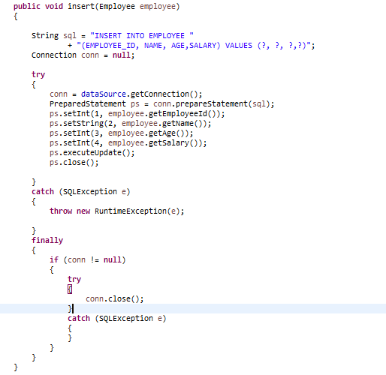
Spring + JdbcTemplate

Slide 2
Spring + JdbcTemplate

